Slide 1

12th National Take Back Day
October 22, 2016
DRUG ENFORCEMENT ADMINISTRATION
DIVERSION CONTROL PROGRAM

Slide 2
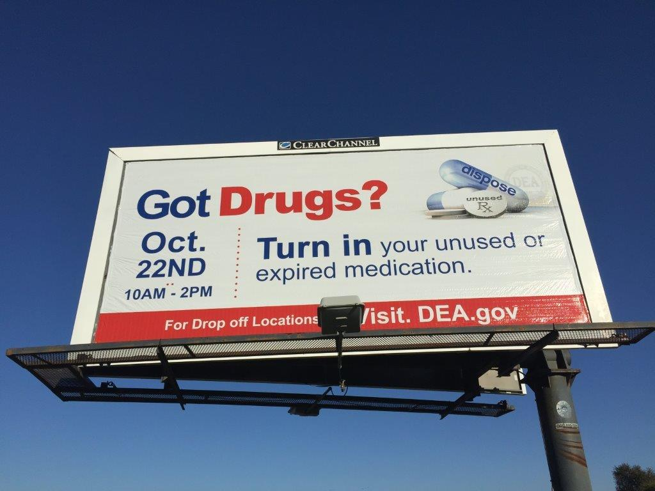

Slide 3


12th National Take Back Day: October 22, 2016
Total Law Enforcement Participation: 4,018
62
35VT
84
NH
21
4
132
16
161MA
49
184
25
20
162
33
RI
13
134
66 CT
71
189
217 NJ
8
28
189
40
184
51
23
DE
226
86
71
126
71
158
68
2
DC
39 MD
111
42
43
7
167
50
44
52
28
42
218
39
9
12
PR & VI
2 HI & Guam
104
Drug Enforcement Administration
Diversion Control Program

Slide 4
12th National Take Back Day: October 22, 2016
Total Collection Sites: 5,178
65
64 VT
85
NH
23
5
160
53
29
157MA
137
28
22
247
35
RI
16
152
73CT
112
327
230 NJ
24
33
54
243
44
223
27
DE
336
114
109
173
92
209
49
7
DC
87 MD
146
72
67
9
196
79
61
69
65
29
296
52
12
30
PR & VI
135
16 HI & Guam
Drug Enforcement Administration
Diversion Control Program

Slide 5
12th National Take Back Day: October 22, 2016
Total Weight Collected (pounds): 731,269 lbs (365.6 Tons)
19,179
3,934VT
8,034
NH
2,572
124
24,002
MA
24,260
7,933
4,402
2,534
RI
3,190
1,733
56,924
38,575
1,282
16,546
6,194
CT
8,556
33,360
12,457NJ
3,079
4,354
28,264
3,713
44,900
6,059 DE
17,546
5,188
51,623
17,458
10,574
36,075
23,270
9,404
10,067
MD
20,271
20,997
874
DC
8,453
769
23,434
4,389
4,968
8,530
2,598
3,545
59,423
2,074
3,535
1092
PR & VI
2,699 HI & GU
16,228
Drug Enforcement Administration
Diversion Control Program
Overseas: 25

Slide 6
National Take Back I-XII Totals:
Total Weight Collected (pounds): 7,202,977 (3,601 Tons)
160,794
34,463VT
70,973
NH
20,738
4,104
219,242
MA
228,700
97,068
84,322
26,039
RI
45,496
16,232
403,026
15,192
133,156
448,142
71,450
CT
77,541
335,887
177,674NJ
29,558
67,267
298,292
60,501
357,071
64,210 DE
205,715
213,388
56,140
675,126
101,345
293,539
224,565
86,745
94,457
MD
128,822
122,192
12,179
DC
111,567
11,989
211,136
46,149
49,120
89,797
16,317
47,425
530,164
29,346
26,890 HI & GU
37,758
219,992
13,951
PR & VI
Drug Enforcement Administration
Diversion Control Program
Overseas: 25

