Slide 1
Notes:
Guidance to presenter: This presentation is intended to be delivered as is. However, please feel free to tailor the provided talking points to suit your community’s needs.
Red Ribbon Week is October 23-31
You might remember the events of this week from elementary school – red ribbons that you wore during the week, the bookmark contest, people like me coming to your class to talk.
I would like to remind you about the history of why we celebrate Red Ribbon Week.

Slide 2
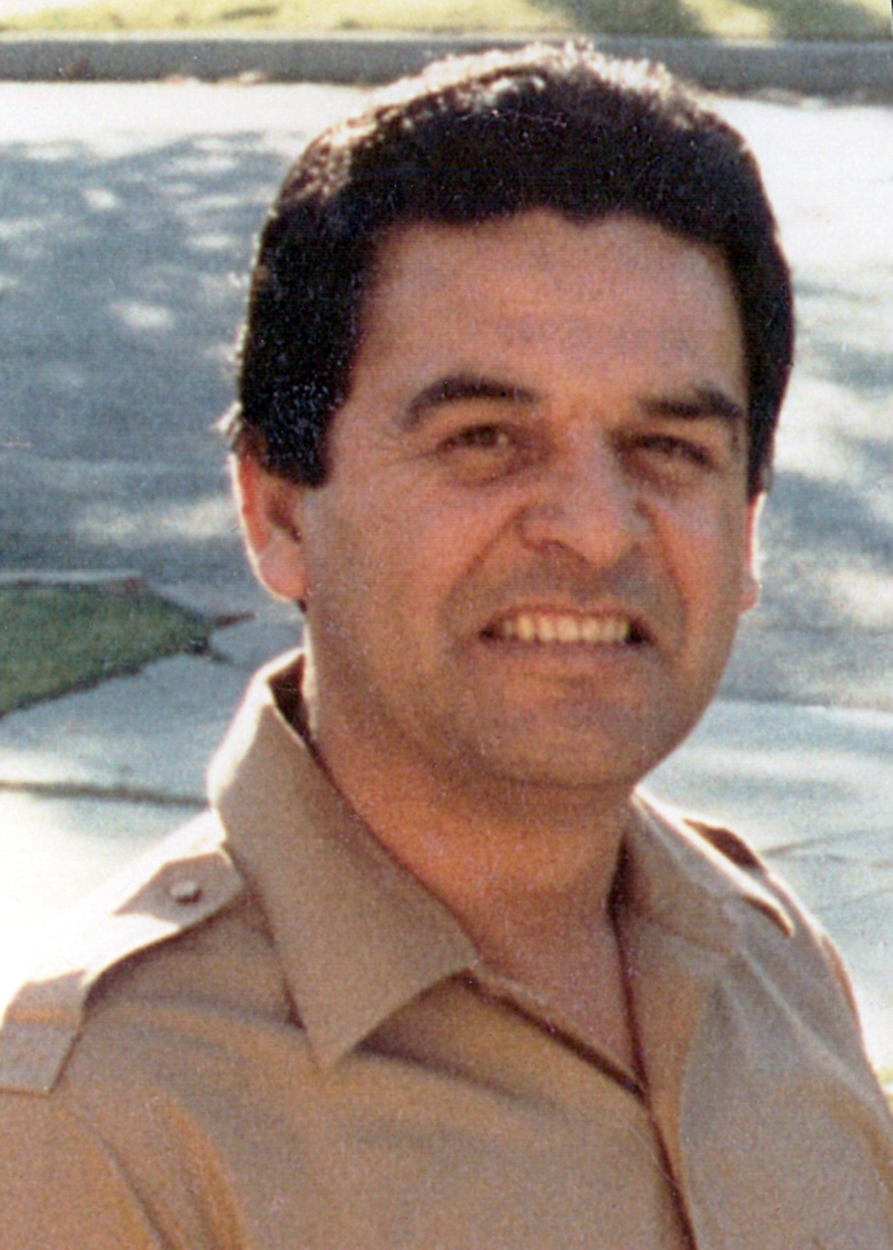
How did Red Ribbon Week come about?
Notes:
How did Red Ribbon Week come about?
On February 7, 1985, Enrique (“Kiki”) Camarena, a Drug Enforcement Administration (DEA) Special Agent, was stationed in Guadalajara, Mexico.
Kiki had been in Mexico for more than 4 years and was on the trail of marijuana and cocaine drug traffickers in Mexico.
At 2:00 p.m. that day, Kiki was going to meet his wife Mika for lunch. As Kiki was about to enter his truck, five men approached and shoved him into a beige Volkswagen and sped away. That was the last time Kiki was seen alive.
Kiki’s body was found one month later in a shallow grave. He had been badly beaten and brutally murdered.
Shortly after Kiki’s death, Congressman Duncan Hunter and Kiki’s high school friend Henry Lozano launched “Camarena Club” in Kiki’s hometown of Calexico, California. Hundreds of club members pledged to live drug-free lives to honor Kiki.
In 1988 the National Family Partnership coordinated the first National Red Ribbon Week with then-President Reagan and Mrs. Reagan serving as honorary chairpersons.
Since then, 80 million people participate in Red Ribbon activities each year.

Slide 3
Why the Red Ribbon?
Red Ribbon Week is a uniform way for communities nationwide to take a stand against drugs and drug use.
Notes:
Why the Red Ribbon?
Red Ribbon Week is a uniform way for communities nationwide to take a stand against drugs and drug use.
The Red Ribbon events and activities help educate individuals, families, and communities about the destructive effects of drug use.

Slide 4
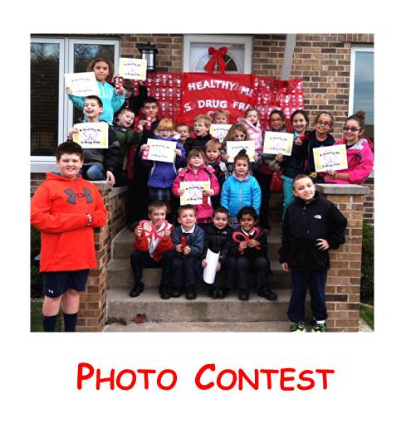
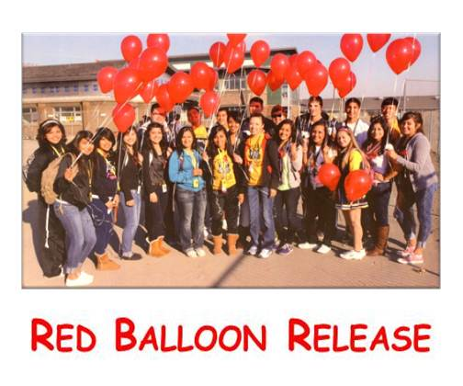
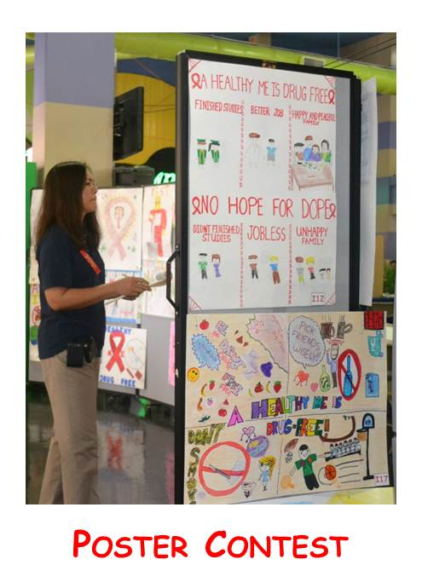
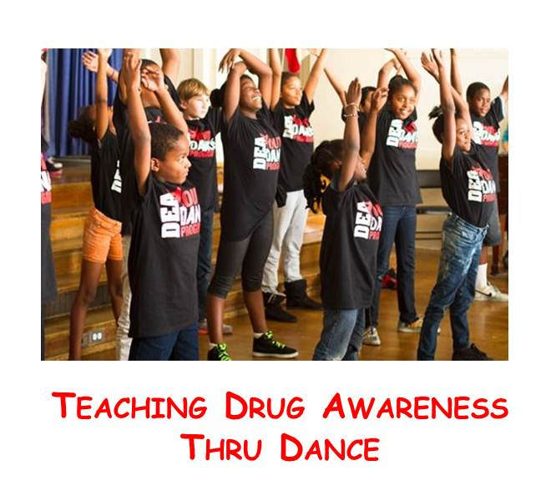
Red Ribbon Week activities
Notes:
Red Ribbon Week Activities
There are lots of ways to celebrate Red Ribbon Week and every part of your community can get involved.
There are activities you can participate in or even initiate, including poster contests and photo contests.

Slide 5
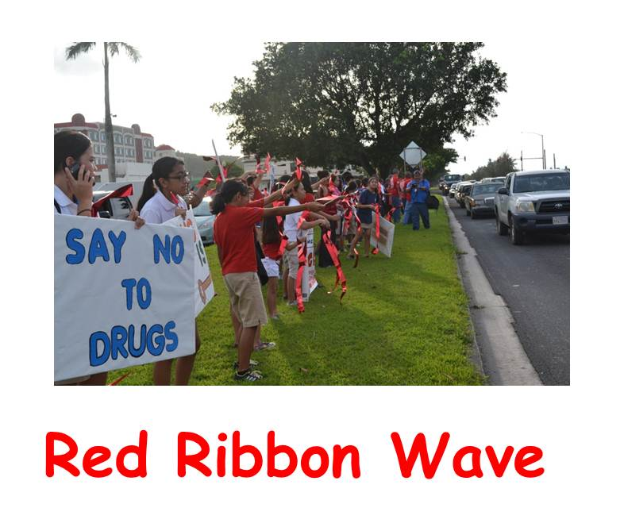
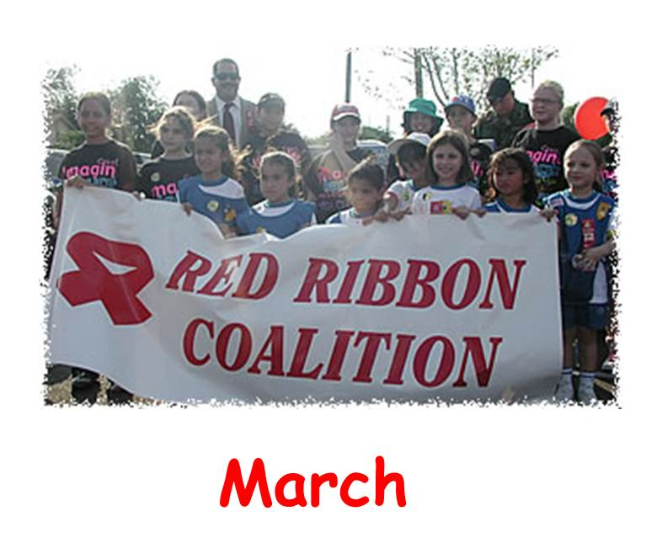
Red Ribbon Week activities
Notes:
Red Ribbon Week Activities
The DEA’s website www.dea.gov has information about Red Ribbon Week and how you can get involved.
Wear red ribbons and distribute them to your friends, family, volunteers, staff, and employees.
Sponsor a Red Ribbon Week activity such as a fun run, bike-a-thon, essay contest, or classroom door decorating contest.
Promote Red Ribbon Week at your school's sporting events by handing out red ribbons, providing information about Red Ribbon Week, and have you and your parents take a drug-free pledge.
Also, I encourage you to talk with me about the events in the community, your ideas, and possible ways you can partner with the local DEA office.

Slide 6
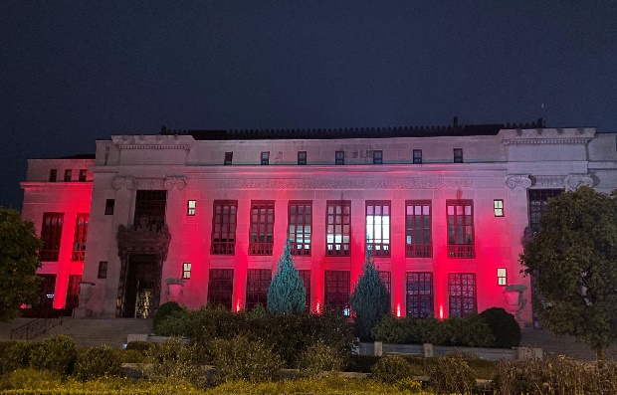
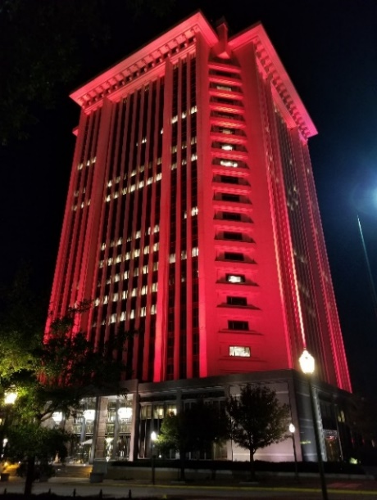
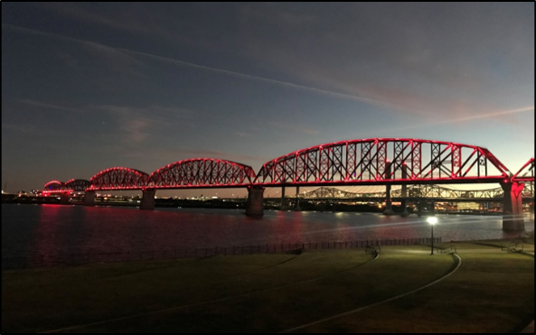
Red Ribbon Week activities
Go Red for
Red Ribbon
City Hall
Columbus, Ohio
RSA Tower
Montgomery, Alabama
St. Louis Wheel Union Station
St. Louis, Missouri
Big Four Bridge
Louisville, Kentucky
Support a drug-free life by lighting up buildings, landmarks, businesses, and bridges in red!
Notes:
Red Ribbon Week Activities
Go Red for Red Ribbon Week is a high profile way businesses and communities can show they are part of Red Ribbon in October each year.
Support a drug-free life by lighting up buildings, landmarks, businesses, and bridges in red! This slide includes just a couple of examples from across the country.
Be sure to post a photo on your social media platforms of what you light up in red for Red Ribbon, and tag #DEARedRibbon and #GoRed4RedRibbon.

Slide 7
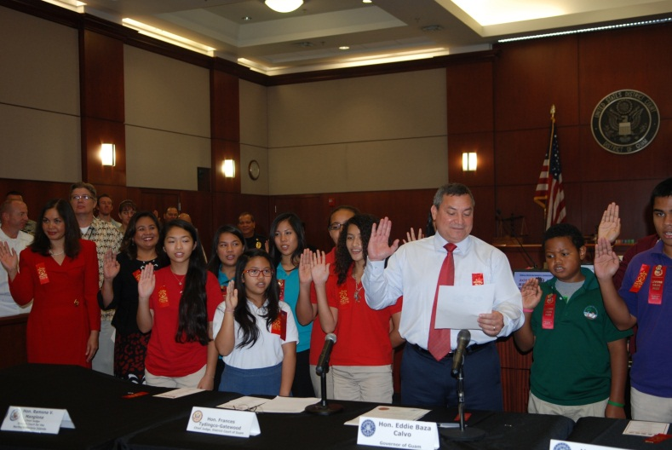
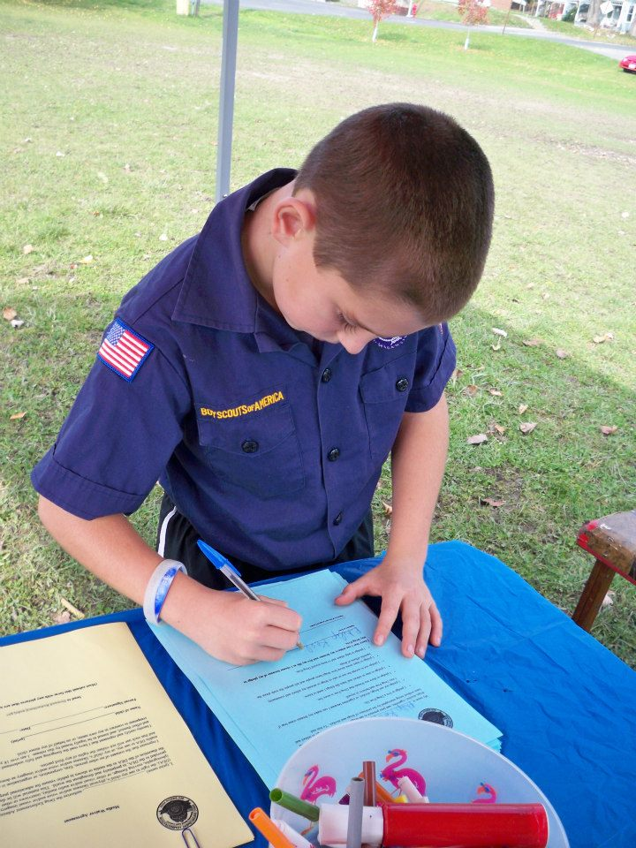
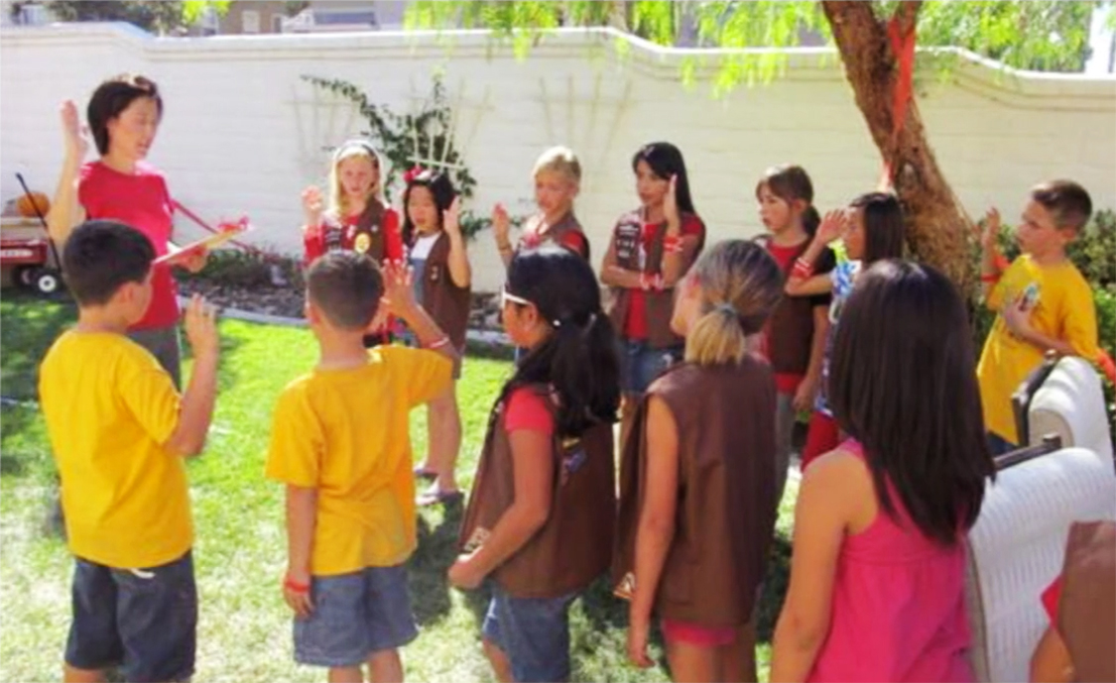
Take the Red Ribbon pledge
Notes:
Red Ribbon Pledge
Here are sample pledges to use at Red Ribbon Week events.
Student’s Pledge
I pledge to stay in school and learn the things that I need to know. I pledge to make the world a better place for kids like me to grow. I pledge to keep my dreams alive and be all that I can be. I pledge to help others and to keep myself drug free.
Parent’s Pledge
We will talk to our children about the dangers of drug abuse.
We will set clear rules for our children about not using drugs.
We will set a good example for our children by not using illegal drugs or medicine without a prescription, or misusing prescription drugs.
We will monitor our children's behavior and enforce appropriate consequences, so that our rules are respected.
We will encourage family and friends to follow the same guidelines to keep children safe from drug abuse.
I pledge to set guidelines to help children grow up safe, healthy, and drug-free.
Parents and students can recite these pledges, or sign and post them in their homes and schools as a reminder of their pledges to be drug-free.
You can access the pledges at www.getsmartaboutdrugs.com/get-involved/red-ribbon-week

Slide 8
Commemorating Red Ribbon Week
Scouts can earn the patch by performing anti-drug activities that reinforce a drug-free lifestyle.
Learn more about the program
www.getsmartaboutdrugs.com/redribbon
Notes:
Commemorating Red Ribbon Week
Boy and Girl Scouts across the United States join the DEA in commemorating Red Ribbon Week, which is a partnership we are very proud of.
Scouts can earn the patch by performing anti-drug activities that reinforce a drug-free lifestyle.
For more information on the program, please go to www.getsmartaboutdrugs.com/redribbon

Slide 9
Red Ribbon Week Campus Video PSA Contest
Co-sponsored by DEA and SAMHSA’s Center for Substance Abuse Prevention
Notes:
Red Ribbon Week Campus Video PSA Contest
The DEA and the Substance Abuse and Mental Health Services Administration have partnered to sponsor this annual contest.

Slide 10
Red Ribbon Week Campus Video PSA Contest
What: For colleges and universities to promote the importance of preventing alcohol abuse and illicit drug use.
Who: Institutions of higher education that offer an associate or baccalaureate degree are eligible.
Visit: campusdrugprevention.gov/psacontest
Notes:
Red Ribbon Week Campus Video PSA Contest
The purpose is for colleges and universities to promote the importance of preventing illicit drug use and legal drug misuse among college students.
The winning school receives a plaque and $1,000 to support its campus’s drug abuse prevention efforts.
For more information, go to www.campusdrugprevention.gov/psacontest

Slide 11
Red Ribbon Photo Contest
Sponsored by National Family Partnership, co-sponsored by DEA.
Notes:
Red Ribbon Photo Contest
DEA co-sponsors the National Family Partnership’s National Red Ribbon Photo Contest.

Slide 12
Red Ribbon Photo Contest
The contest is for schools and families, who decorate their home or school around the national Red Ribbon theme and the public votes to select the winning entries.
www.redribbon.org/contest
Notes:
Red Ribbon Photo Contest
The contest engages families, schools, and communities to actively spread the Red Ribbon Week message.
The National Family Partnership coordinated the first National Red Ribbon Week celebration in 1988.
For more information, go to www.redribbon.org/contest

Slide 13
More Information
Notes:
For more information about the DEA and Red Ribbon Week, please go to the following websites:
www.dea.gov/redribbon
www.justthinktwice.com - DEA’s website for teens
www.getsmartaboutdrugs.com - DEA’s website for parents, teachers and caregivers
www.campusdrugprevention.gov - DEA’s website for professionals working to prevent drug abuse among college students

Slide 14
dea.gov/redribbon
Notes:
I’m happy to answer any questions you might have and to hear about Red Ribbon Week activities you have planned.
Thank you!

